Slide 1
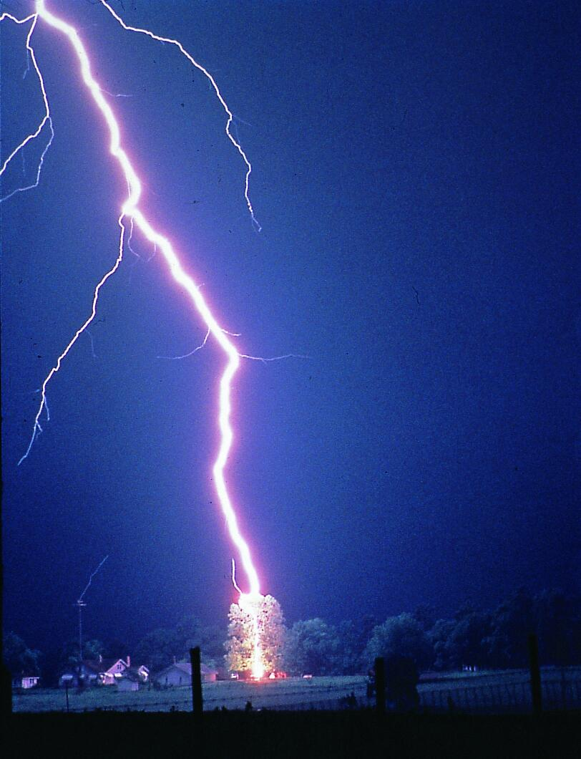
Lightning Path 閃電路徑模擬
吳由由
高為勳
方淑玲

Slide 2
Lightning path
Electrons take all available paths, and it will choose the path of the least resistance.
And you may wonder
How lightning find its path??

Slide 3
Before the main strike, the electricity travels toward the earth in many random paths like many random walkers.
As soon as a path found to the earth the big strike happens exactly through that special path.
Indeed the lightning doesn't know where the road is, it searches to find it.

Slide 4
閃電路徑的形成
先導閃電(stroke leader):
光度較弱但速度較快
由雲層傳遞至地面
高速運動的電子會產生強大電場，將空氣電離化
回返閃擊(return stroke):
高亮度、由地面傳播至雲層的回擊
是一般看到的高熱、高能量閃電
回擊通路的高溫使空氣膨脹，當膨脹速度超過音速
→ 產生音爆

Slide 5
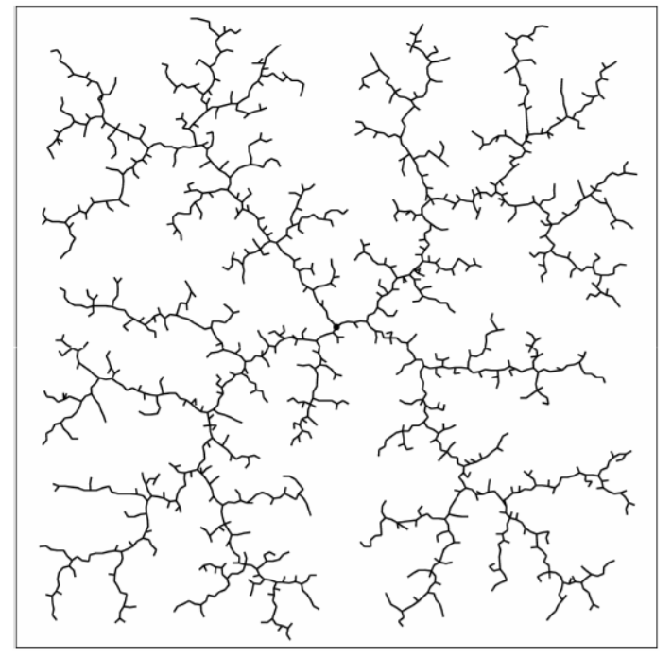
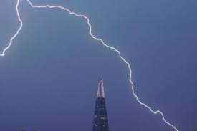
Simulation – RRT Algorithm
Rapidly-Exploring Random Tree
Constructed by a tree
Every nodes is connected to a single parent
The tree is rooted at start location

Slide 6
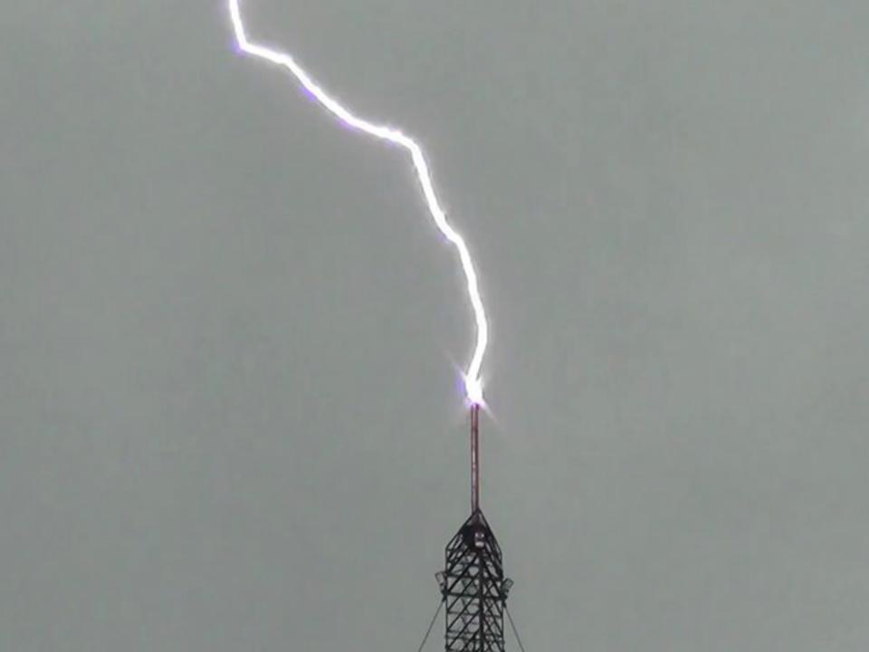
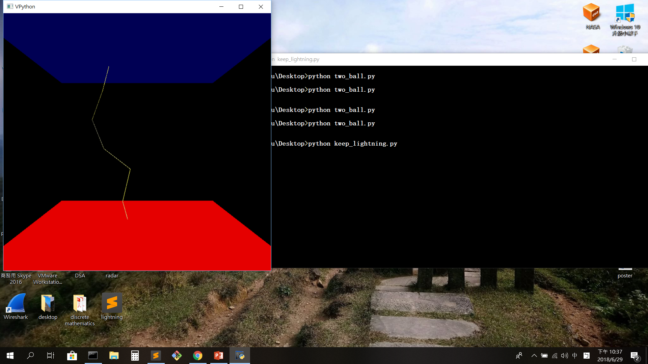
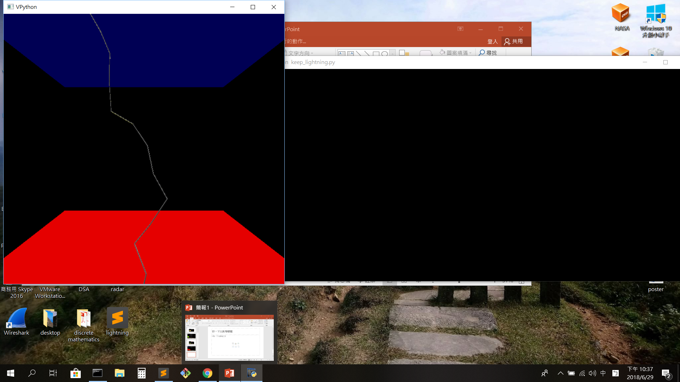
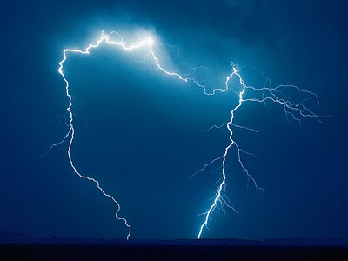

Slide 7
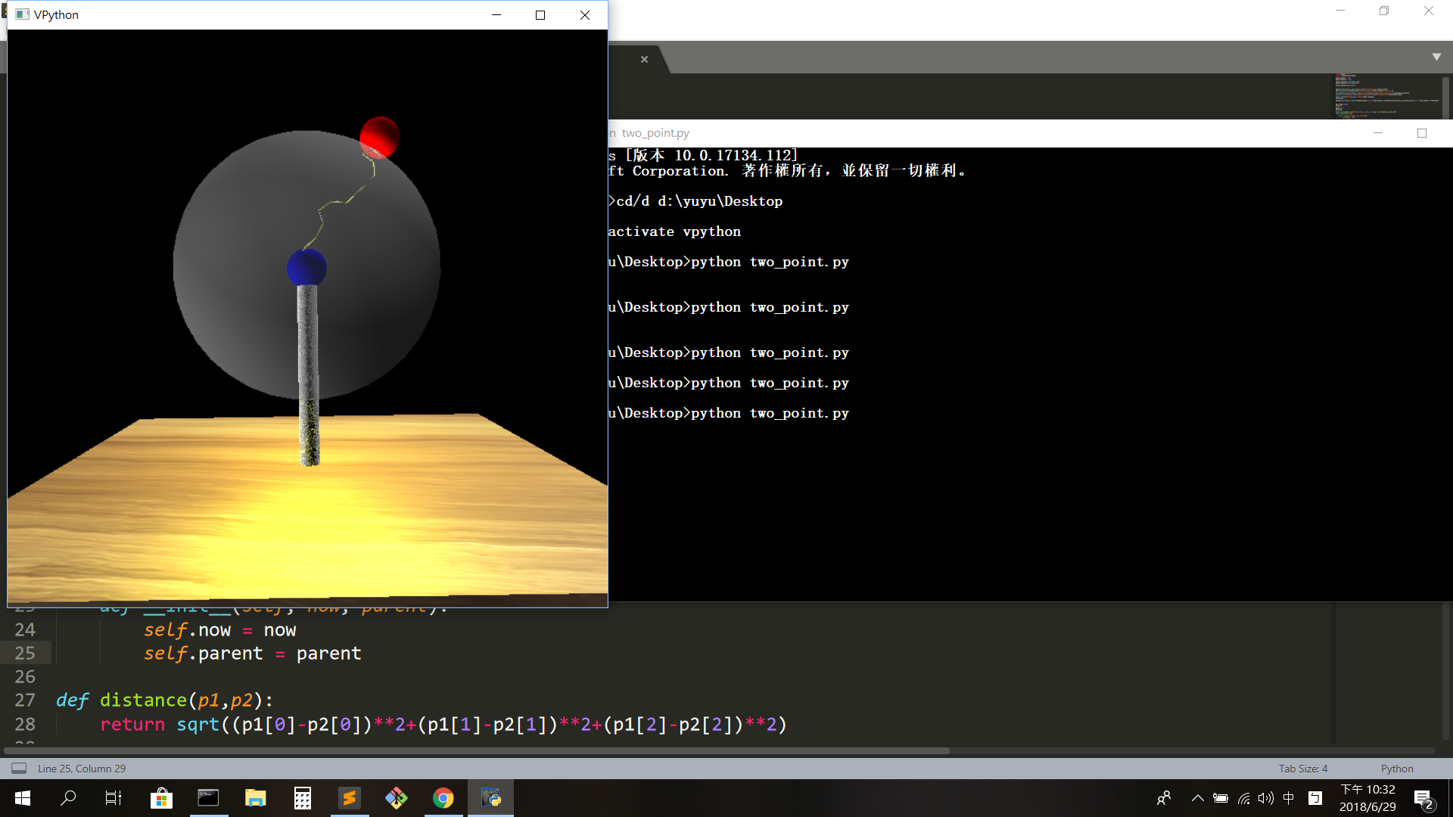
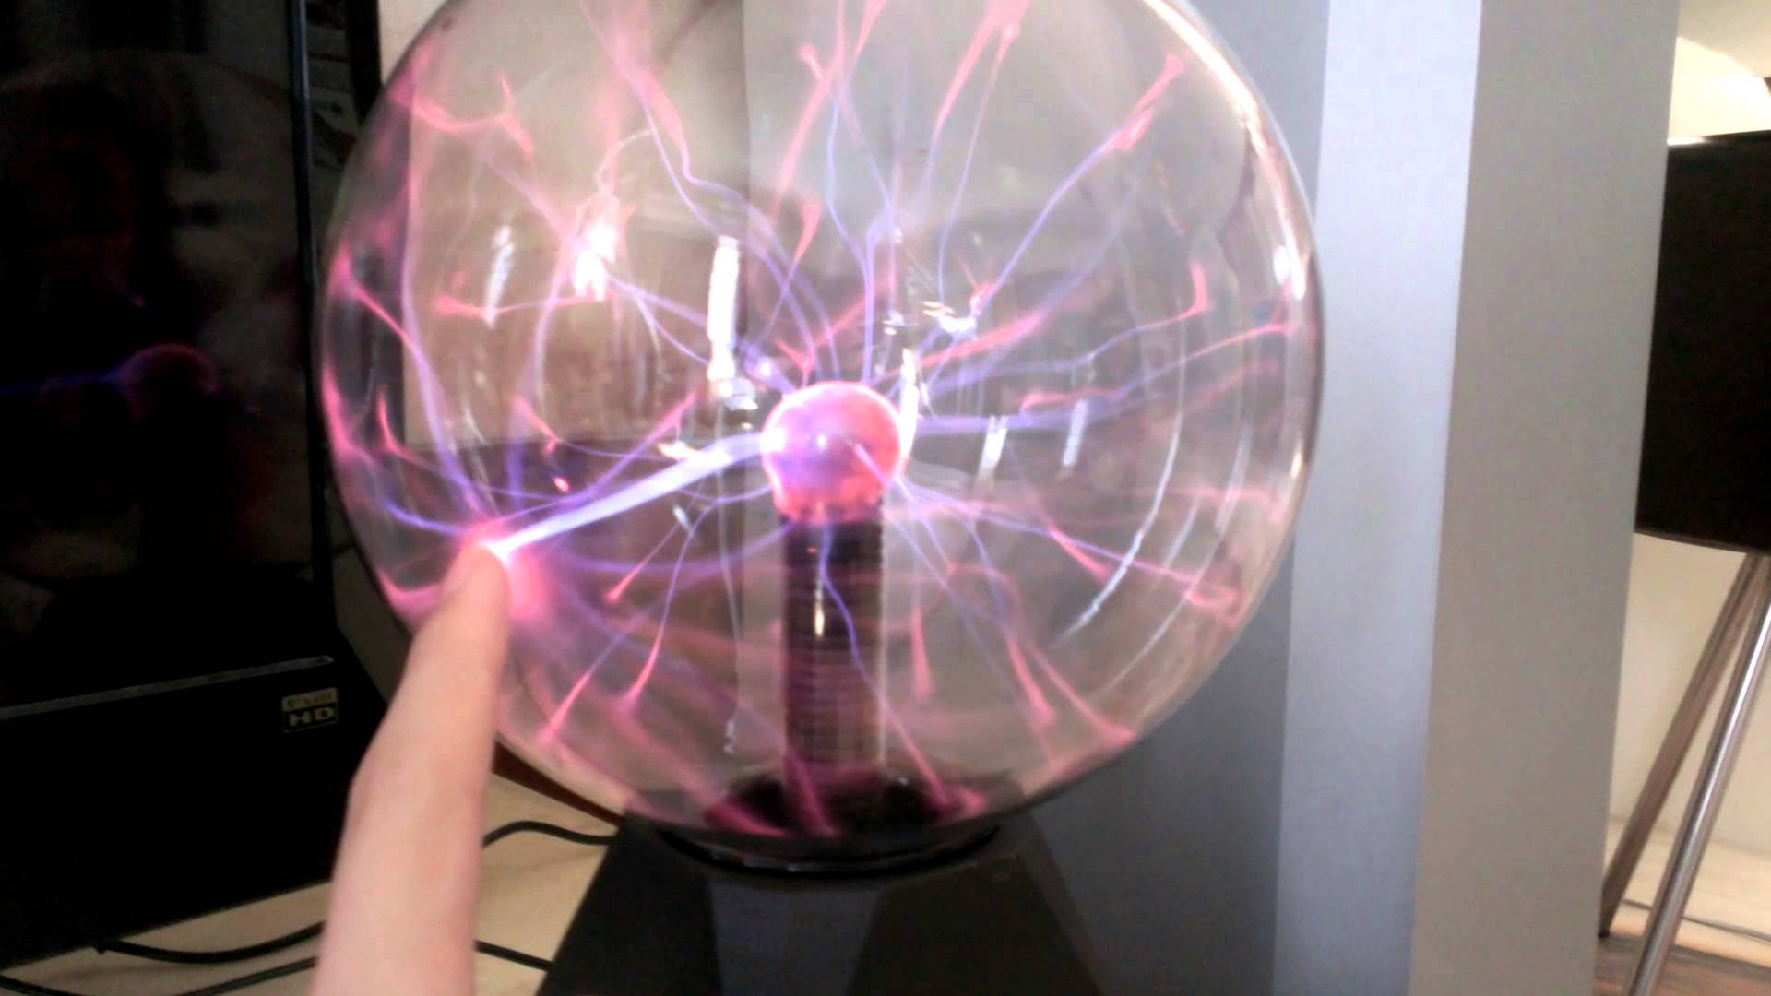

Slide 8
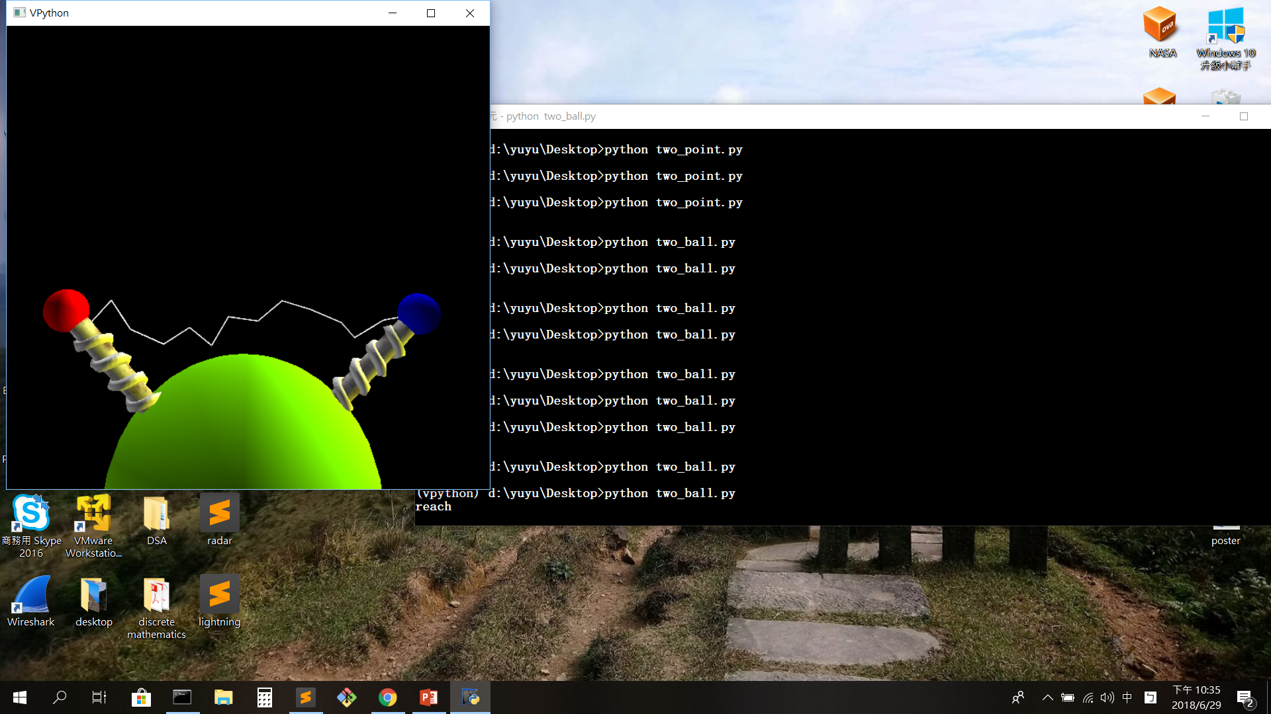
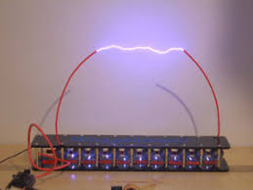
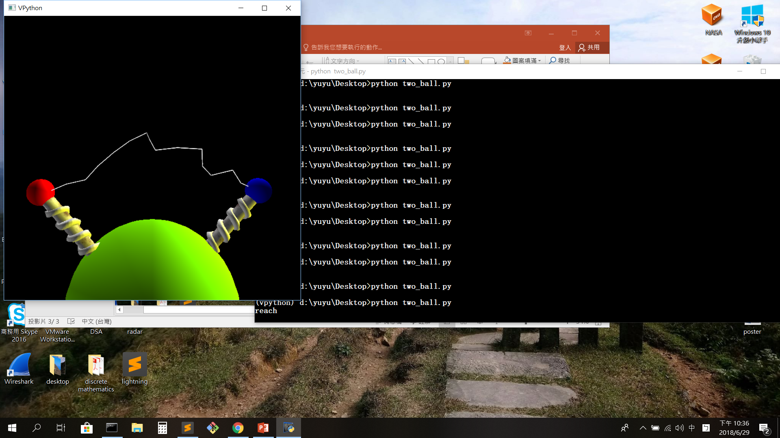
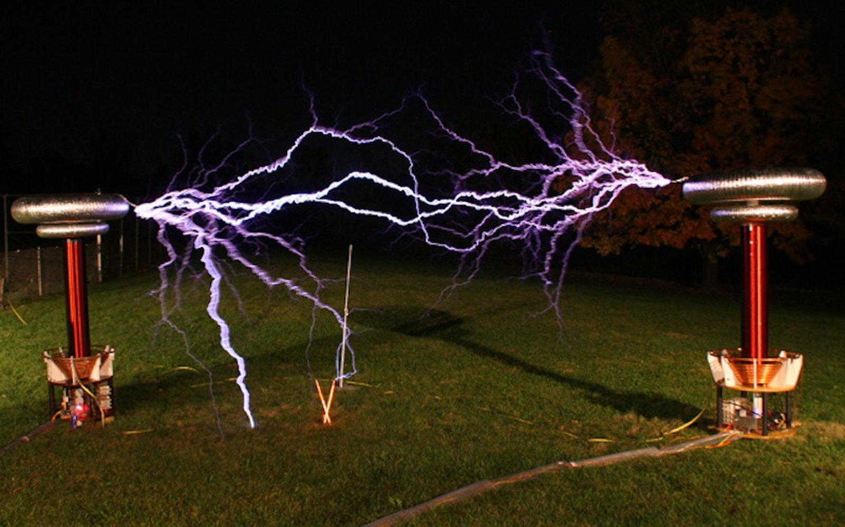

Slide 9
https://www.youtube.com/watch?v=JVXy-ZqqZ-g

